Slide 1
In General...
RED
CHAIR
BLUE
COUCH
HOLD UP 3 FINGERS
FURNITURE
FLOWER
ROSE
COLOR

Slide 2
Reasonable Results in Reasonable Time Frames
BY… | You Should Be… | And Have Saved At Least…
Year 5
Debt Free
$100k - $250k
Financially Independent
Year 10
$1,000,000
Year 20
WEALTHY
$5,000,000
IF you have:
Followed the PFS Solutions in your FNA
Lived below your means and stayed lean & mean
Built your PFS Business & therefore grown your income!
For training purposes only.

Slide 3
Reasonable Results in Reasonable Time Frames
Time | Promotion | Income
6 Weeks
District Leader
$1–3,000/month
3 Months
Division Leader
$2–5,000/month
6 Months
Regional Leader
$3–10,000/month
12 – 36 Months
RVP
$ 100,000+
3 – 5 Years
SVP
$ 250,000+
5 – 7 Years
NSD
$ 500,000+
7 - 10 Years
SNSD
$ 1 Million +
For training purposes only.

Slide 4
Building Your Primerica Business
People have to...
Like you
Trust you
Believe you can get them where they want to go.
CHARACTER - SKILLS
GOALS

Slide 5
BUILDING YOUR PRIMERICA BUSINESS!
DREAM
DREAM
“Make no small plans, for they have no power to stir the souls of men.”
– Victor Hugo
“If you don’t build your own dream, someone else will hire you to help them build theirs.”
–Tony Gaskins Jr
“Where there is no vision, the people perish.” – Proverbs 29:18

Slide 6
Building Your Primerica Business
Leader
Followers
People always give their commitment to those with the deepest rooted conviction.
You will only testify to the level of your convictions!
People are going to give their commitment to someone and something, the only question is to what and to whom.

Slide 7
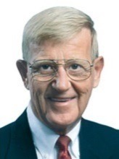
THE COACH APPROACH
Great Teams are made up of
Great Players and Great Coaches!
How do you recruit great players?
What do great players look for in a coach?
Lou Holtz:
Can They Trust You?
Do you have Integrity? = Do you do what you say you are going to do?

Slide 8
THE COACH APPROACH
2. Do you Care about Them?
Say and Show
Communication
Relationships
3. Are you committed to excellence?
Skills (Total Humility) : Do you know how to get where you say you want to go, and if they decide to go there, can you teach them how to get there?
Will (Resolute Will) : Will you go the distance, and continue to the price for greatness?
4. Do you have a Positive Winning Attitude-HOPE
Do you believe tomorrow will be better than today?
Do you know and believe in where your going?
Are you constantly casting and selling your VISION?

Slide 9
THE COACH APPROACH
Practice the T.E.A. Concept:
Teach/Encourage/Assist
The players don’t need another enemy, they need an ally.
When a player makes a mistake, it’s an opportunity to coach, not criticize.

Slide 10
THE COACH APPROACH
John Madden On Players
Show up on Time
Do What They Are Asked To Do
Give It All They Have

Slide 11
THE COACH APPROACH
LEADERSHIP SKILLS
Educate
Motivate
Tolerate (Accept)
Communicate
Build Relationships

Slide 12
THE COACH APPROACH
What Great Coaches Look For In Players:
Gym Rats
Play Hurt
Late Bloomers
Team Players
Killer Instinct
Can They and Will They Play?

Slide 13
THE COACH APPROACH
VIP
VTP
VNP
VDP

Slide 14
Building Your Primerica Business
Transfer Theory
Leader
(New)
Leader
(You)
Knowledge
Confidence
Responsibility

Slide 15
Building Your Primerica Business
Discipleship Principle Vs. Evangelist
DISCIPLES 1 2 4 8 | CONVERTS 365,000 730,000 1,095,000 1,460,000
DISCIPLES 1 2 4 8 16 32 64 128 256 512 1,024 2,048 4,096 8,172 16,344 32,688 65,376 130,752 261,504 523,008 1,046,076 2,092,032 4,184,064 8,368,128 16,736,256 (25 YEARS ) 33,472,512 66,945,024 133,890,048 267,780,096 535,560,192 1,071,120,384 2,142,240,768 4,284,481,536 8,568,963,072 (34 YEARS) | CONVERTS 365,000 730,000 1,095,000 1,460,000 1,825,000 2,190,000 2,555,000 2,920,000 3,285,000 3,650,000 4,015,000 4,380,000 4,745,000 5,110,000 5,475,000 5,840,000 6,205,000 6,570,000 6,935,000 7,300,000 7,665,000 8,030,000 8,395,000 8,760,000 9,125,000 9,490,000 9,855,000 10,220,000 10,585,000 10,650,000 11,015,000 11,380,000 11,745,000 12,110,000
Disciples 1 per year
Coverts 1,000 / day
Notes:
16
32
64
128
256
512
1,024

Slide 16
Building Your Primerica Business
How Wide Do You Need to Be?
Income | Premium | Recruits | Width
$1 million | $150k | 150 Rec | 25 + You
$750k | $100k | 100 Rec | 20 + You
$500k | $75k | 75 Rec | 15 + You
$350K | $50k | 50 Rec | 10 + You
$250K | $30k | 30 Rec | 5 + You
$125K | $15k | 15 Rec | 3 + You

Slide 17
Building Your Primerica Business
BUILDING STAGES:
Enlarging
Empowering
Equipping
Enlisting
Engage

Slide 18
Building Your Primerica Business
The System
Enlist
Equip
Empower
Engage
ENLARGE

Slide 19
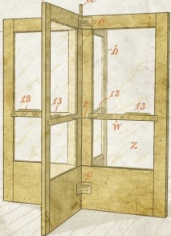
Building Your Primerica Business
Get them IN & THROUGH the System!
The System

Slide 20
Building Your Primerica Business
Get them IN & THROUGH the System!
The System

Slide 21
Reasons People Fall Through the System
They lose sight of their goals.
They listen to the wrong people. (not coachable)
They fail to apply the proven PFS success system.
They quit too soon.
They don’t work hard enough.

Slide 22
Reasons People Fall Through the System
We fail to keep their goals in front of them.
We fail to be the loudest voice in their head.
We fail to provide proper direction and instruction. i.e. teach the PFS proven success system.
We quit on them too soon.
We don’t work hard enough for them.

Slide 23
Building Your Primerica Business
Bird Dog Theory

Slide 24
Building Your Primerica Business
Bird Dog Theory

Slide 25
Building Your Primerica Business
Bird Dog Theory

Slide 26
Building Your Primerica Business
Stay Pregnant And
Constantly Give Multiple Births

Slide 27
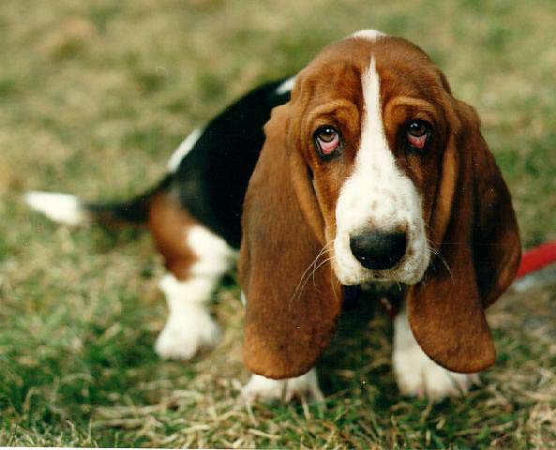
Building Your Primerica Business
Engage
“Scary”
Obnoxious
“Lazy” Apathetic
“Irritating” Annoying

Slide 28
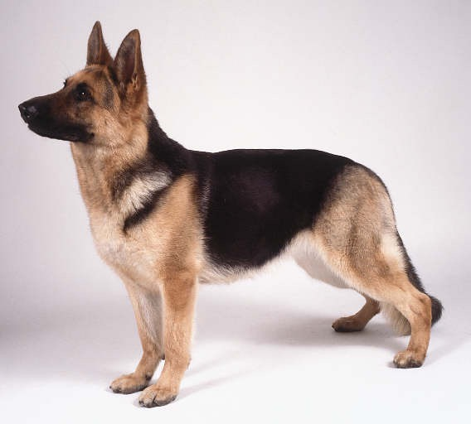
Building Your Primerica Business
Engage
Guide
&
Protect
Like/Trust

Slide 29
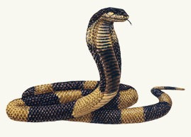
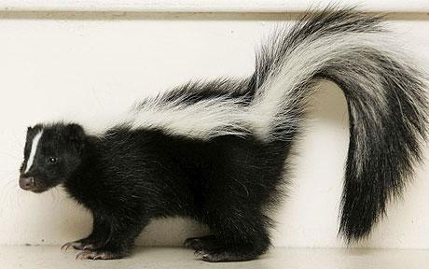
Building Your Primerica Business
Engage

Slide 30
Building Your Primerica Business
Others Run FROM You
Others Run TO You

Slide 31
Building Your Primerica Business
Crap Magnet
Success Magnet
You attract what you ARE, not what you WANT!
So if you want to attract a more attractive TEAM,
you must become a more attractive PERSON!

Slide 32
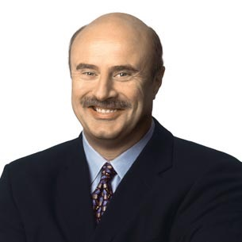
Prospecting/Recruiting
Dr. Phil on Recruiting
Target-Rich Environment
Change Your Routine
Become a “Rabbit Recruiter”.
BILL WHITTLE TRAINING MATERIAL

Slide 33
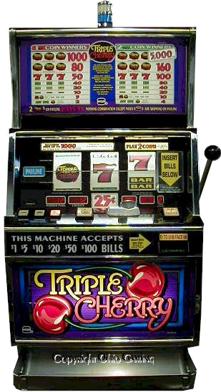
Prospecting/Recruiting
You must be a COMPULSIVE BELIEVER!
“You never know when the next person you talk to/recruit will be the next Mario Arrizon or Blake Whittle!”
Art Williams
BILL WHITTLE TRAINING MATERIAL

Slide 34
Prospecting/Recruiting
Develop A Sense Of Urgency
Now
Next
Always “Assume”
This is the one.
The timing is right.
They love their family.
They are responsible.
They are not stupid.
RVP
Quit
BILL WHITTLE TRAINING MATERIAL

Slide 35
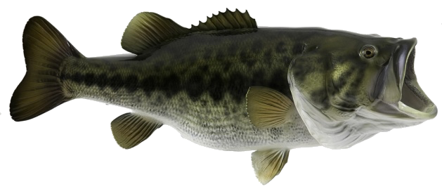
Prospecting/Recruiting
Winners are Chasers! (Bass vs. Carp)
You can’t control who bites, only the amount of lures you cast and the attempts you make.
Remember the Sermon on the Mountain.
VS.
BILL WHITTLE TRAINING MATERIAL

Slide 36
Building Your Primerica Business
Creative
Management
Justification
Condemnation
CHAMPIONS ALWAYS STAY IN THE CREATIVE STAGE!!!

Slide 37
THE COACH APPROACH
Remember: That weak players need to be told what to do…
AND
That strong players want to be told what to do!
Both the weak and the strong must know that you (the Leader) know how to win at PFS — Know and Teach
“THE SYSTEM!”

Slide 38
THEORIES
Doubt
Fear
Confidence
Belief

Slide 39
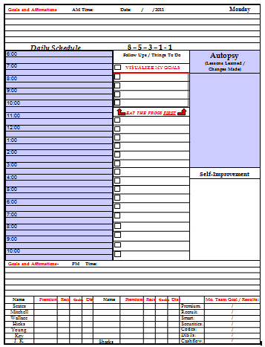
THE COACH APPROACH

Slide 40
THE COACH APPROACH
Think In Ink
You can’t expect what you don’t inspect
Eat the FROG
Pack the BIG BAGS FIRST
Student-FARMER
Remember: You can’t change what you don’t acknowledge… AUTOPSY!
Remember: IPA!!!
If it doesn’t help you reach your goals:
DON’T DO IT!!

Slide 41
THE COACH APPROACH

Slide 42
THE COACH APPROACH
Doubt
Fear
Confidence
Belief

Slide 43
ACTIVITY
Waterfall Theory

Slide 44
ACTIVITY
Flashlight Theory

Slide 45
ACTIVITY
Red Light/ Green Light

Slide 46
ACTIVITY
Keeper of the Keys

Slide 47
ACTIVITY
Plug-In Theory

Slide 48
ACTIVITY
Pipeline Theory

Slide 49
ACTIVITY
45 Day Wonder
Monday
Tuesday
Wednesday
Thursday
Friday
Saturday
Sunday
Week 1
Week 2
Week 3
Week 4
Week 5
Week 6

Slide 50
ACTIVITY
Water Pump Theory

Slide 51
THE COACH APPROACH
S
S
S
ub
tarter
tar
Decide what level you want to play!
Agree on the price it will take!

Slide 52
THE COACH APPROACH
S
S
S
ub
tarter
tar
Thief
Gambler
Champion
You must have the mindset and the activity of a Champion!

Slide 53
THE COACH APPROACH
8 – 5 – 3 – 1
Qualified Appointments
Committed FNA’s
Qualified Committed Closes
Qualified Committed Recruit
Thief?
Gambler?
Champion?

Slide 54
THE COACH APPROACH
S
S
S
ub
tarter
tar
Decide what level you want to play!
Agree on the price it will take!
Agree on the amount of accountability you’re willing to accept and expect!

Slide 55
Champion Detector
1. Get off to a Fast Start
2. Attend all Meetings
3. Get Others to Meetings
Set Their Own Appointments /
Have Credibility on Appointments
5. Ask the Right Questions
6. Do a Self-Study
7. Handle Rejection — Mad vs. Down
8. Handle Change — Excited vs. Upset
9. Want to Compete Early
10. Go on Their Own Early

Slide 56
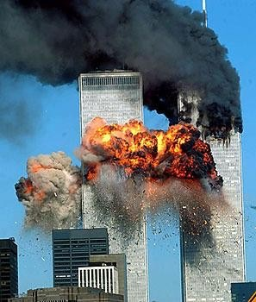
GOALS
After 9/11 a politician was asked:
“Will we ever lose our American Way of Life?”
The politician’s response:
“As long as our resolve to maintain our American way of life is stronger than the terrorists’ resolve to destroy our American way of life, we will preserve our American Way of Life.”

Slide 57
Ping Pong Ball Theory
Building Your Primerica Business
Show Up On Time Everyday! (365)
Show Up with a Positive Winning Attitude!
Take Your Pull!

Slide 58
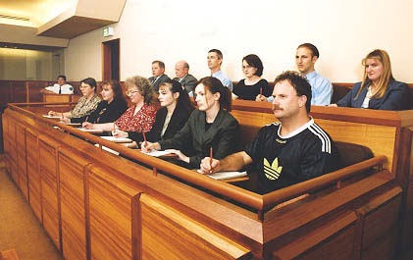
Building Your Primerica Business
It all comes down to DESIRE.
How BAD do you really really want IT?
Will there be enough evidence to Convict you of being serious about what you really want?

