Slide 1
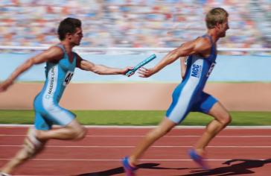
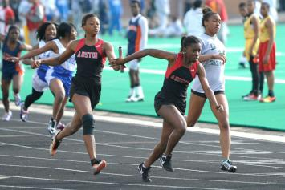
REACH & RUN

Slide 3
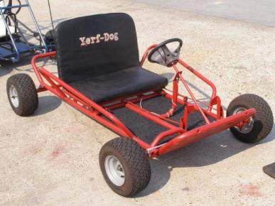

Slide 4
Goals Demand Change

Slide 5
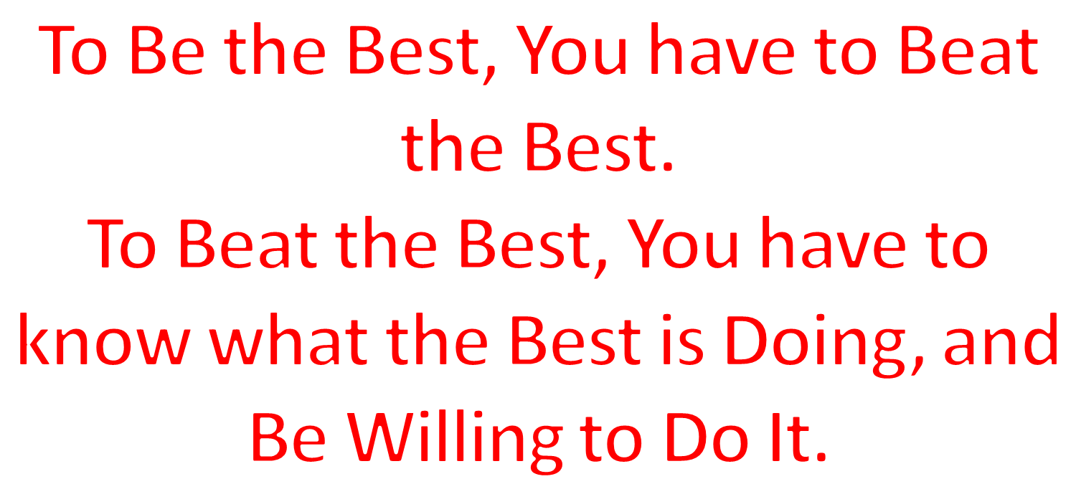
Goals Demand Change

Slide 6
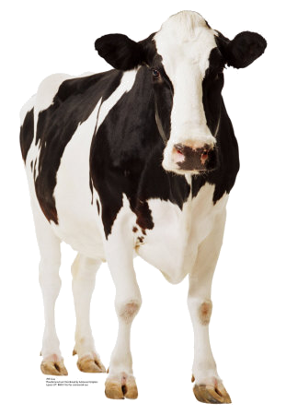
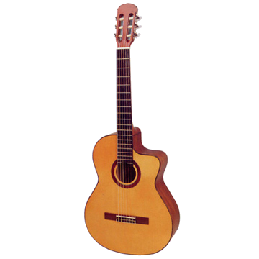
Goals Demand Change
When the going gets tough, the tough get going — when the going gets tough, the weak flake out!
Remember — Winners go through everything that the Losers aren’t willing to go through!
Pawn Shop
Cow Patty
Tree

Slide 7
Goals Demand Change
If you don’t have what you said you wanted:
You really didn’t want it bad enough!
You were attempting to negotiate the price!
The desire to eliminate pain isn’t strong enough!
The desire to experience pleasure isn’t strong enough!
No one or Nothing is that important to you!

Slide 9
Goals Demand Change

Slide 10
Goals Demand Change

Slide 11
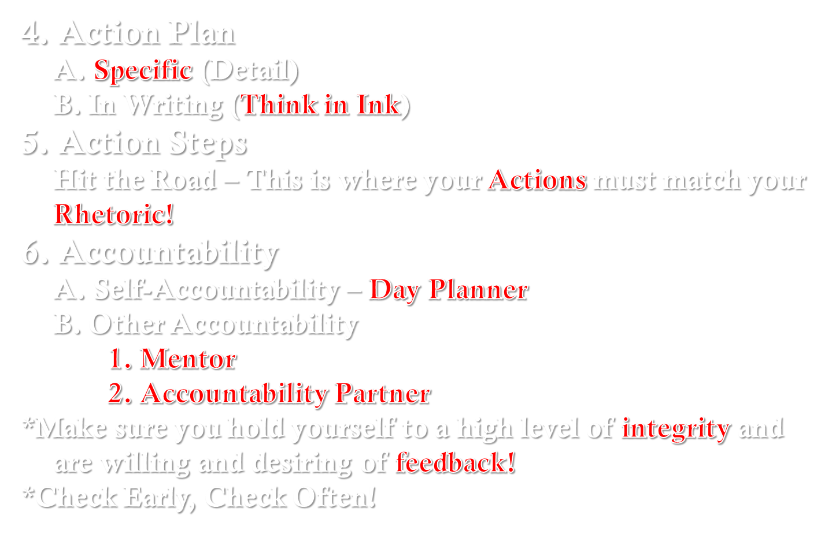
Goals Demand Change

Slide 12
What Is IT?

Slide 13
What Is IT?
YOU

Slide 14
What Is IT?
Birth
YOU
Turn Back
ABORT
Quit

Slide 15
What Is IT?
Break Through
Birth
YOU
Turn Back
Recommit
ABORT
Quit

Slide 16
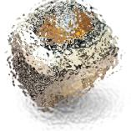
YOUR GOAL
F
O
C
U
S
OBSTACLES
DISTRACTIONS
APATHETIC CASUAL OBSESSED

Slide 17
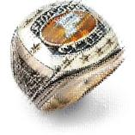
YOUR GOAL
F
O
C
U
S
OBSTACLES
DISTRACTIONS
APATHETIC CASUAL OBSESSED

Slide 18
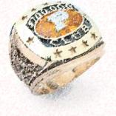
YOUR GOAL
F
O
C
U
S
OBSTACLES
DISTRACTIONS
APATHETIC CASUAL OBSESSED

Slide 19
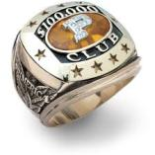
YOUR GOAL
FOCUS
OBSTACLES
DISTRACTIONS
APATHETIC CASUAL OBSESSED

Slide 20
FIND THE ARROW

Slide 21
FIND THE OLD LADY AND YOUNG LADY

Slide 22
HOW MANY “F’S” ARE IN THE FOLLOWING SENTENCE?

Slide 23
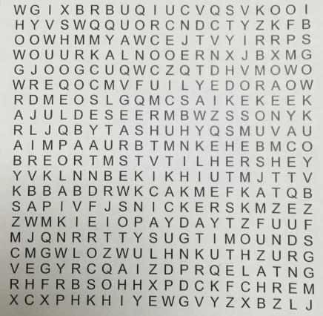
CANDY BARS
Almond Joy
Butterfinger
Hershey
KitKat
Milky Way
Mounds
Mr Goodbar
Musketeer
Payday
Reese
Score
Skybar
Smores
Snickers
Twix

Slide 24
REMEMBER WHY YOU’RE RUNNING

Slide 25
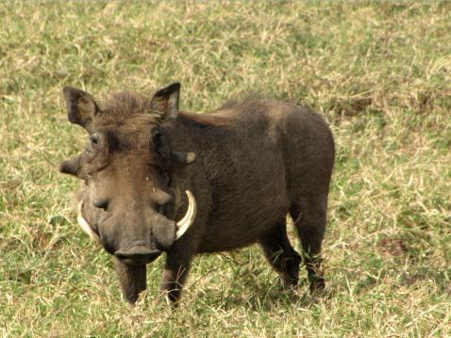
REMEMBER WHY YOU’RE RUNNING!

Slide 26
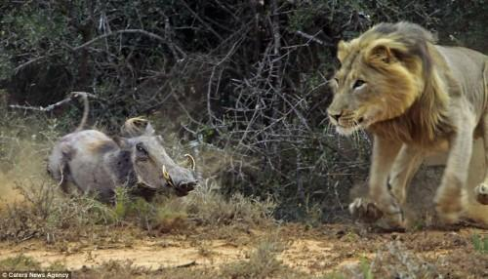
REMEMBER WHY YOU’RE RUNNING!

Slide 27
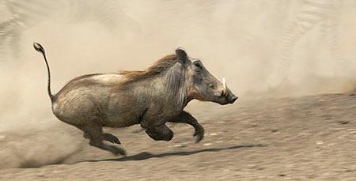
REMEMBER WHY YOU’RE RUNNING!

Slide 28
REMEMBER WHY YOU’RE RUNNING!

Slide 29
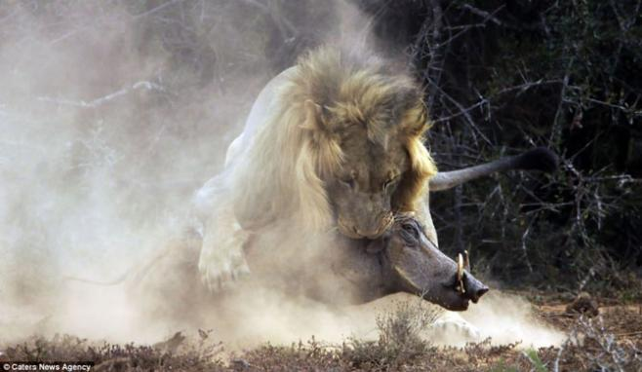
REMEMBER WHY YOU’RE RUNNING!

Slide 30
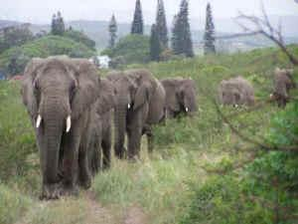
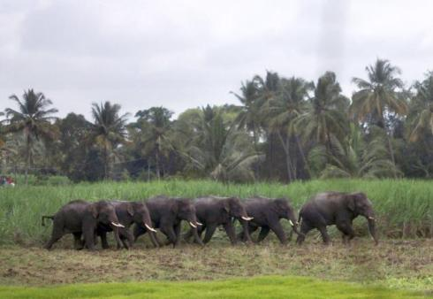
REMEMBER WHY YOU’RE RUNNING!

Slide 31
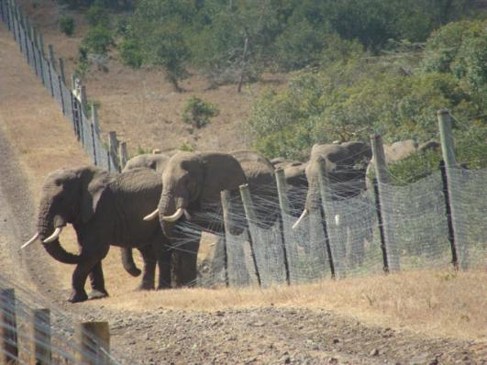
REMEMBER WHY YOU’RE RUNNING!

Slide 32
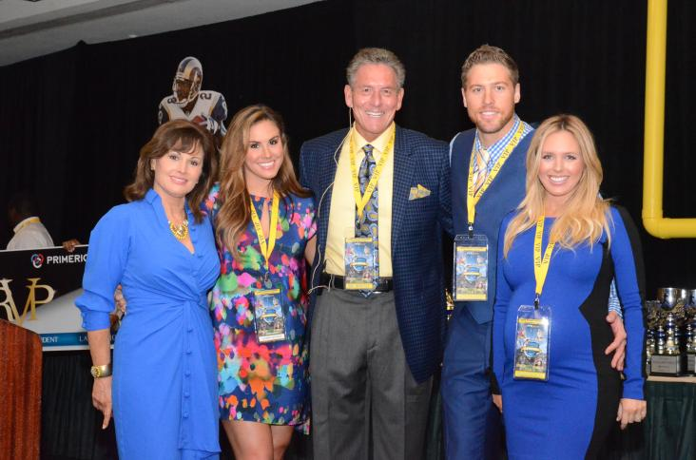
THE FAMILY

Slide 33
THE FAMILY

Slide 34
THE FAMILY

Slide 35
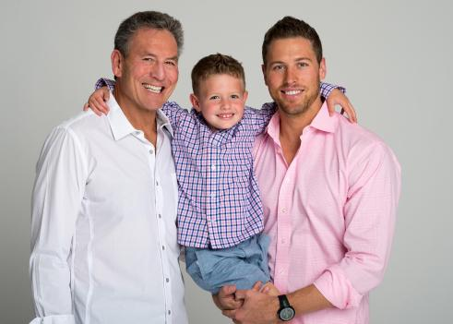
THE FAMILY

Slide 36
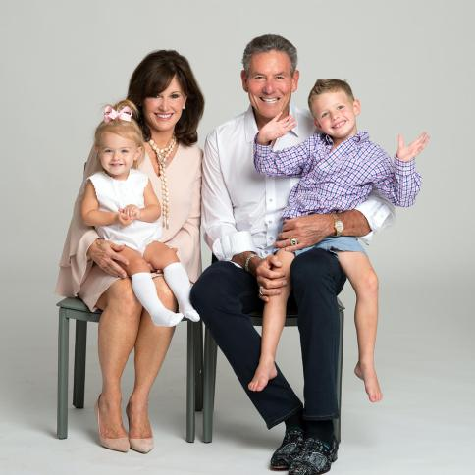
THE FAMILY

Slide 37
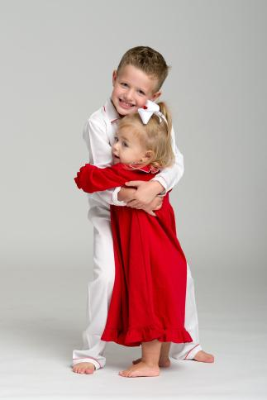
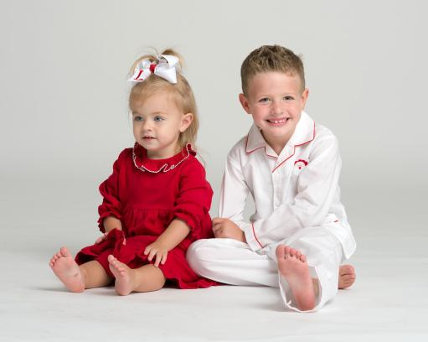
THE FAMILY

Slide 38
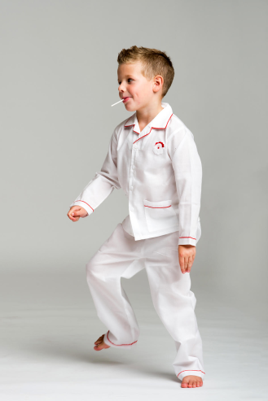
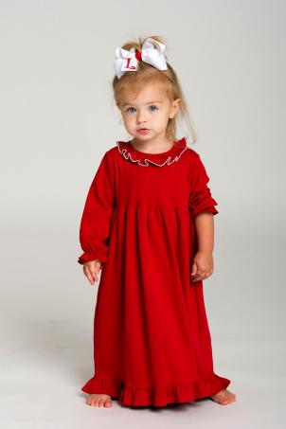
THE FAMILY

Slide 39
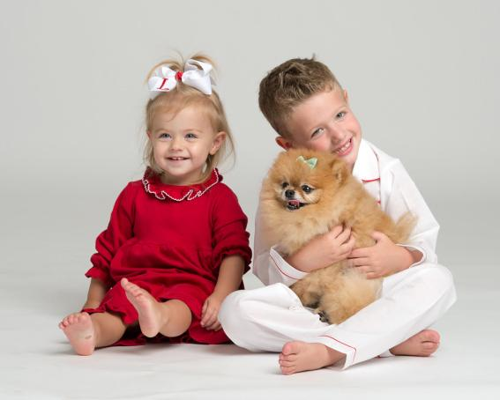
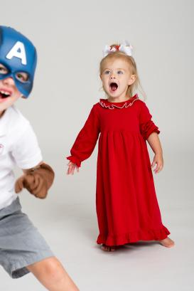
THE FAMILY

Slide 40
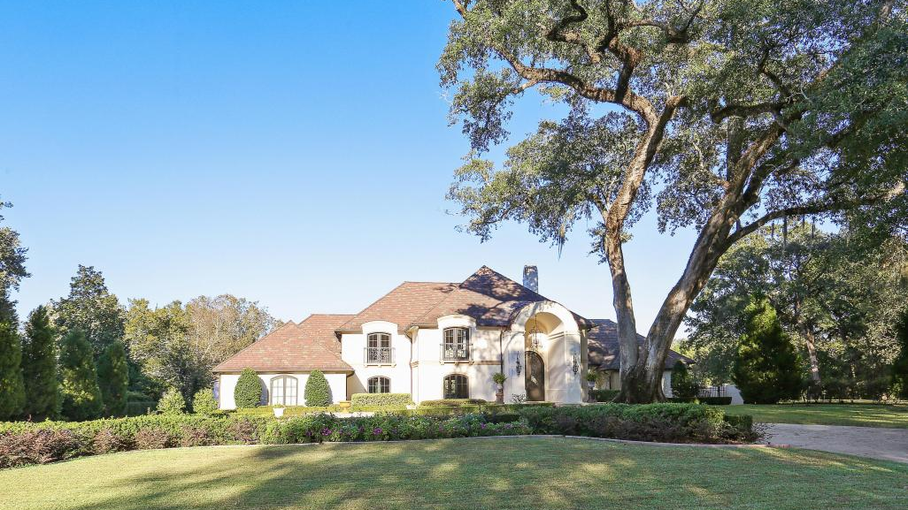

Slide 54
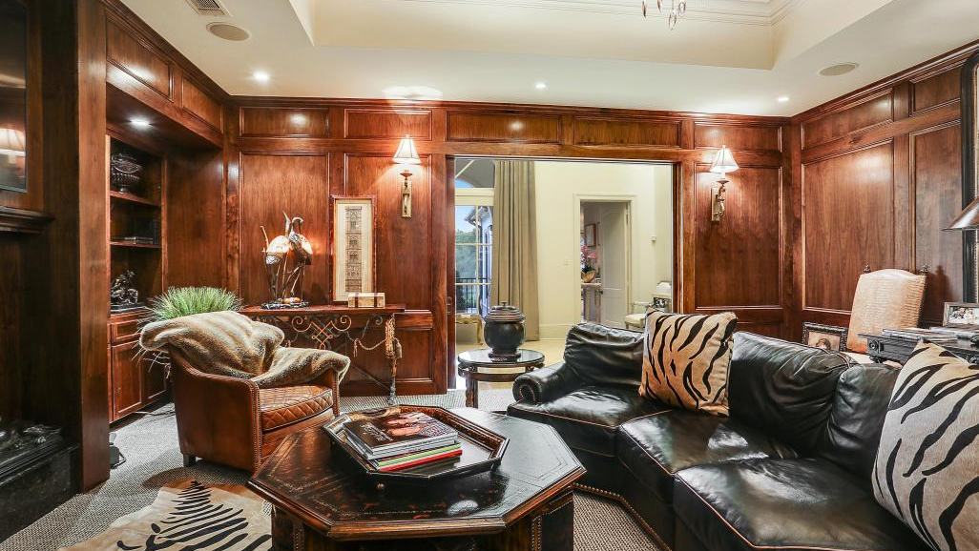

Slide 72
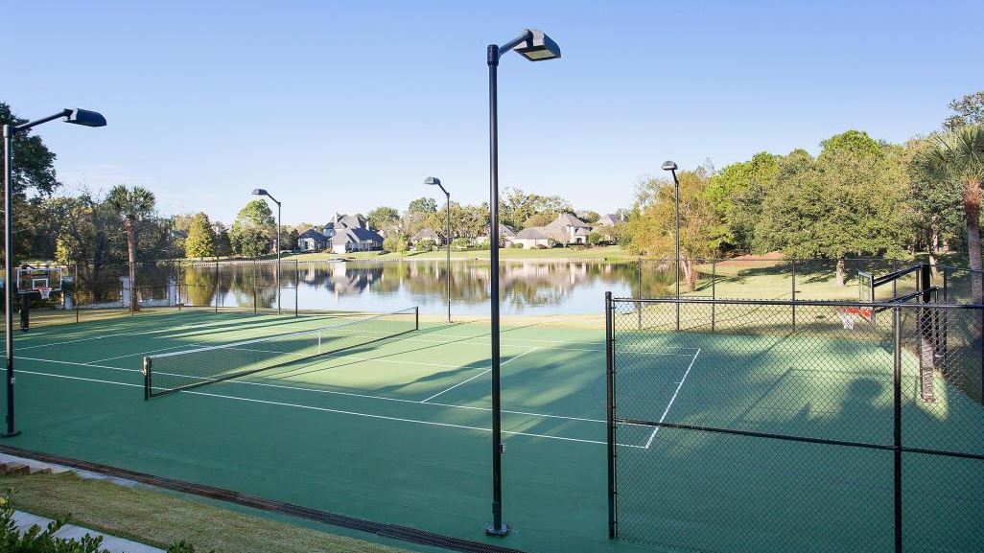

Slide 73
MY FAMILY & PATTI’S TEAM

Slide 74
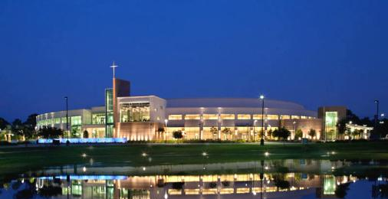
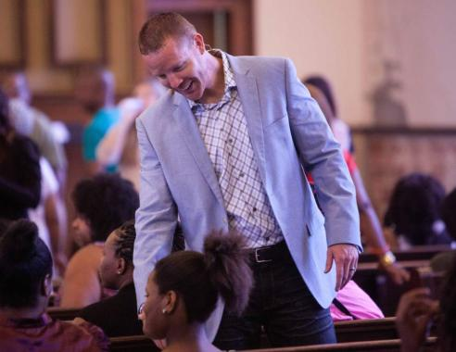
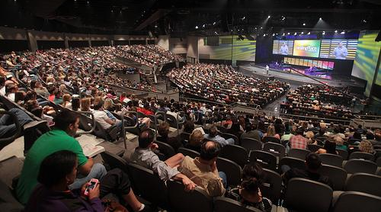

Slide 75
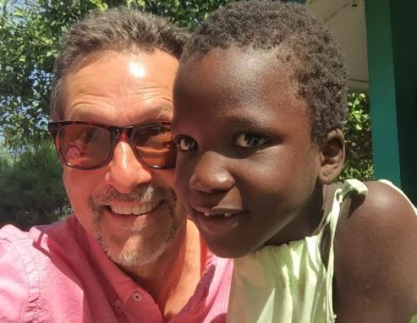
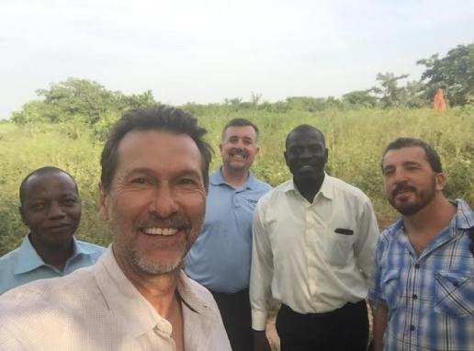

Slide 76
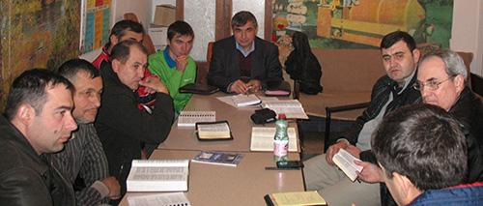
HARVEY NEWTON

Slide 77
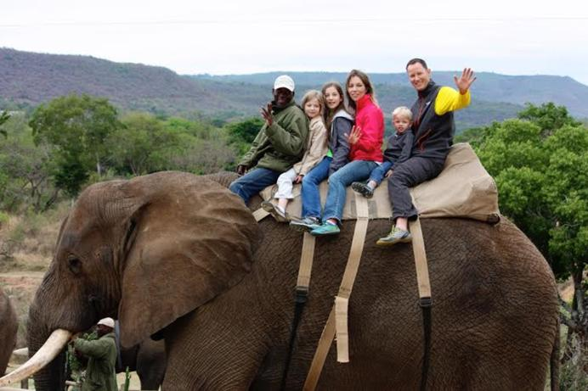
MISSIONARY ROBERT REED & FAMILY

Slide 78
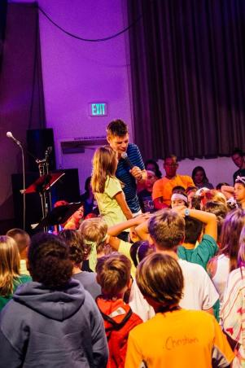
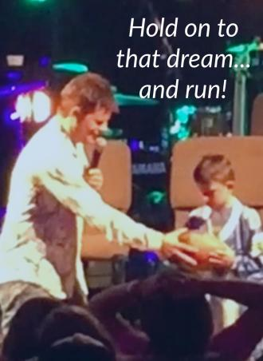
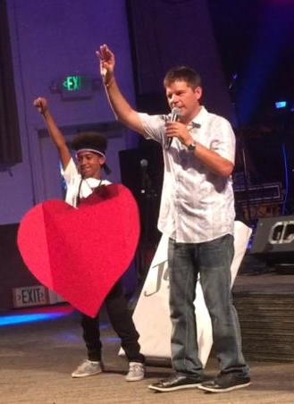
TIM CARPENTER CHILDREN'S MINISTRY

Slide 79
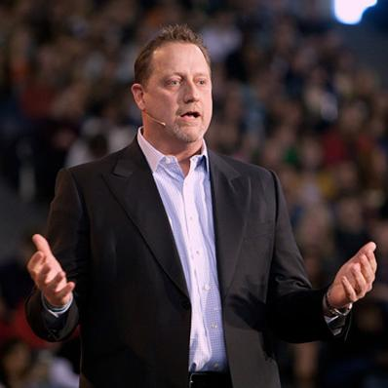
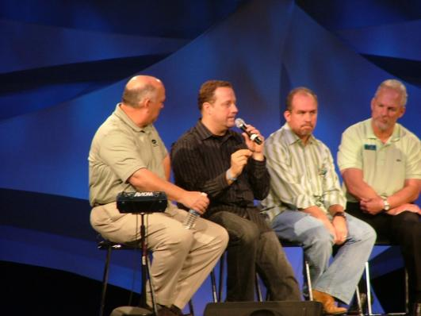
DINO RIZZO PASTORAL MINISTRIES

Slide 80
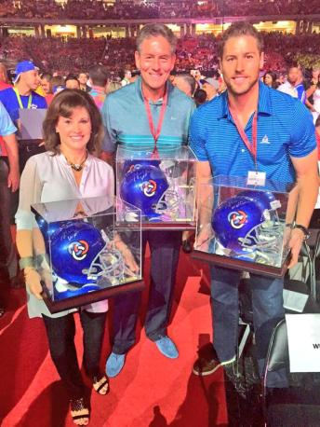
THE COMPETITION

Slide 81
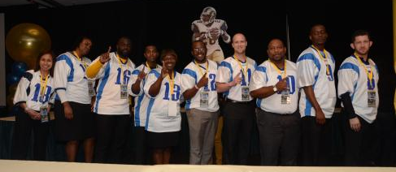
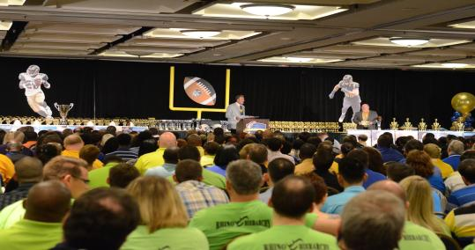
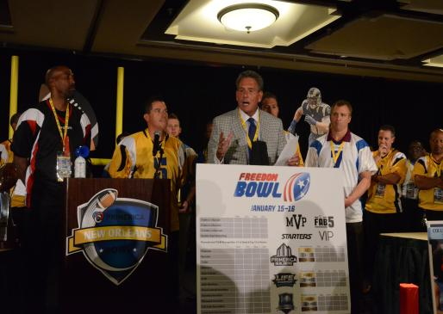
THE TEAM

Slide 82
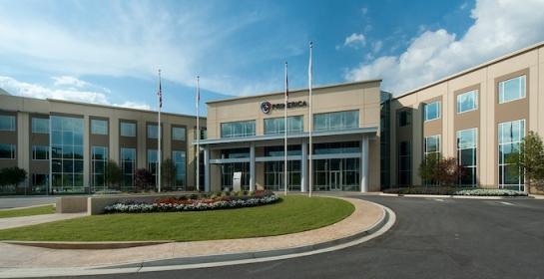
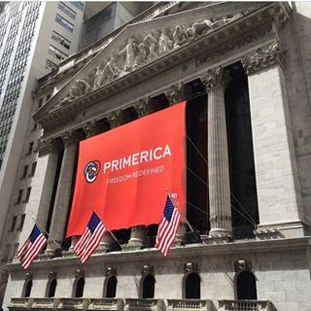
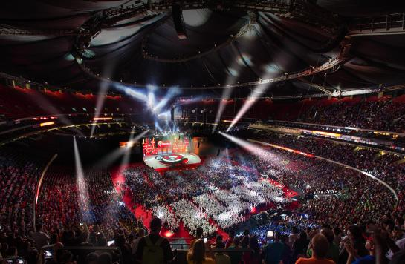
THE COMPANY

Slide 83
REMEMBER WHY YOU’RE RUNNING!

Slide 84
REMEMBER WHY YOU’RE RUNNING!
DON’T BE A WARTHOG

Slide 85
REMEMBER WHY YOU’RE RUNNING

